Slide 1
ORL 5524-Sessions 8.0-9.0
Item-writing guidelines and examples
Instrument Design and Validation
Madhabi Chatterji, Ph.D.
Professor of Measurement, Evaluation and Education
Director, Assessment and Evaluation Research Initiative (AERI)
Teachers College, Columbia University

Slide 2
Today’s Focus
Commonly used Assessment Methods/ Formats:
  Written multiple choice (structured response) tests
  Written constructed-response tasks and essay assessments
  Portfolio-based assessments
  Product-based or project-based assessments
  Behavior-based and performance assessments
  Survey- or Interview-based assessments

Slide 3
AGENDA: Item-writing Guidelines
LAST WEEK-
Domain specification guidelines for cognitive, affective, health and social constructs
THIS WEEK- HOW TO DEVELOP/SELECT ITEMS AND “ITEM POOL”
Item-writing guidelines for
a) highly structured response items
Multiple choice, true false, completion items (cognitive constructs)
b) Likert type-scale or rating scale items (non-cognitive,
health-related or social constructs)
c) Complex, interpretive exercises (cognitive constructs)

Slide 4
Item-writing Guidelines
HOW TO DEVELOP AN ITEM POOL
Item-writing guidelines for highly structured response items tied to indicators in domains
Cognitive Constructs
Goal: Maximum perf./capacity measurement; right, degrees of correctness, or wrong answer
  Multiple choice, true false, completion items
  Complex, scenario-based interpretive exercises
Non-Cognitive Constructs
Goal: Measurement of typical variability in responses, behavior or attitude:
  Likert-scale or rating scale items (affective, health and social constructs)

Slide 5
Cognitive Constructs Measurable with Highly Structured-Response Items
Educational achievement (point in time, learning outcomes/products, mastery in curricula or training program)
“Learning progressions”-Expertise building in domains on a continuum (learning processes, products and learning progressions towards expertisse, tied to curricula or training)
Professional Competency (point in time, job performance domains)
Aptitude (point in time, future potential in a criterion domain).
Intelligence (point in time or developmental, multifaceted intellectual capacities that manifests itself, and evolves over one’s life spans

Slide 6
Process Model still applies!
Building validity into item design processes
Clear domain specifications: Start with the specified construct, and the general and specific indicators that define the domain.
Thoughtful item selection or writing: Write or create an item or task to match indicator specifications; OR select the item or task from an existing source/assessment/tool.
Good directions, graphics etc.: Write directions for respondents/examinees and assessment administrators.
Scoring: Clarify the response scoring key, methods or mechanisms to arrive at a total score (or derived score, if needed).
Content-validate: Perform a content validation of the items against the specified domain, through expert or peer review processes
Item pool: Create an “item pool” to meet your design specifications

Slide 7
APPLICATION –EXAMPLE
Elementary Education-
Mathematics
Chapter 7 of Chatterji (2003) book

Slide 8
Higher Order Mathematical Problem Solving—Excerpted Domain and Item Examples for elementary/middle grade students
  :
  1.0 General Indicator—the culminating learning outcome in a course:
  Given a mathematical sequence, student/examinee will recognize the pattern and continue it by performing the necessary arithmetic operations without a calculator (Complex procedural skills)
  Specific Indicators (knowledge, competencies, skills):
  1.1. Define the concept of a mathematical pattern. ( ?)
  1.2 Give examples of a repeating mathematical pattern versus mathematical sequence that increases based on a rule. ( ?)
  1.2 Given a sequence, identify and continue a pattern of numbers or numerals
  ( ?)
  1.3 Calculate the sum of the terms in a given number sequence. (?)
  1.4 Apply a strategy to solve a math problem and explain it. ( ?)
  Matching Multiple Choice/Constructed response Items:
  1. Calculate the product of (1+2)*(2+3)*(3+4)* (__+__)* (__+__) =?
  (a) 35
  (b) 945
  (c) 10395
  (d) 103966
  (e) None of the above
  _____________________
  Explain how you arrived at your answer (your strategy):
  2. What is a mathematical sequence? Give an example of an increasing sequence.

Slide 9
Higher Order Mathematical Problem Solving for elementary/middle grade students—ITEM EXAMPLES
Holistic Scoring Rubric for Items :
3= Uses trial and error or other reasonable strategies to identify mathematical pattern correctly, continues pattern correctly, and explains the process in clear mathematical language
2= Uses trial and error or other reasonable strategies to identify mathematical pattern correctly, continues pattern and explains process, but makes some errors/omissions
1= To some extent, is able to use trial and error or other reasonable strategies to identify mathematical pattern correctly and continue I but; shows many confusions in explanation of process, makes many errors.
0= Unable to complete any or most parts of the problem and communicate mathematically

Slide 10
Content validation of structured response items tapping a cognitive construct —guiding questions
Is the item a plausible match for the domain/indicator specifications—namely, the content, cognitive behavior, conditions or performance criterion specified in the domain indicators?
Is there clearly one correct or reasonable answer that is acceptable?
Is the item free of grammatical, semantic or other clues?
Does the item have a heavier reading load in the stem?
Is the item direct and clear (easy to understand, without tricky language)?
Is the item free of any obvious or inherent biases (language, cultural, or other)?
Is the answer key accurate?
If there are constructed response sections,
  Is there a scoring rubric that ensures that results have (a) high levels of content-based validity—i.e., match with indicators, and (b) acceptable levels of inter-rater reliability—i.e., structured guidelines to control for random variations among examiners ?

Slide 11
Additional Content-Validation Checklist for Multiple Choice Items:
1. Is there only one question or idea in the stem?
2. Are the responses parallel in form and content?
3. Are responses about equal in length?
4. Are "All of the above" or "None of the above" used sparingly and with judgment?
5. Does the correct answer position vary in a list of items?
6. Are responses to items listed in some logical order?
7. Are response options listed vertically?
8. Are response options to an item of about equal difficulty?
9. Are the distracters plausible? Do they reflect common errors or misunderstandings in typical examinees?

Slide 12
Content Validation Exercise (Items from the Metropolitan Achievement Test Series)
Domain:
General Indicator:
1.0 When writing paragraphs in English, student will apply rules/conventions of grammar and syntax correctly in sentences.
Specific Indicator(s):
1.1 Identify parts of speech in sentences given.
1.2 Identify correct tense of verbs in sentences given.
1.3 Apply writing conventions, grammar, and syntax correctly in simple sentences.
Cognitive levels?
Which indicators are tapped?
Which items will need rubrics?
Are these items “Content Valid”?
Read these two sentences to answer Items 1-4.
We arrived at the bus station early.
Everyone wants a seat by the window
1. An adverb in these sentences is __
(E) early
(F) bus
(G) everyone
(H) By
2. A past tense verb in these sentences is __
station (B) wants (C) the (D) arrived
3. Write a sentence in the past tense using a noun and a verb.
4. Write a paragraph describing how you spent your last weekend.

Slide 13
APPLICATION –EXAMPLE
Self-report Items
(Survey- or Interview basedAssessments)
Chapter 9 (a little bit of 8) of Chatterji (2003 ) book

Slide 14
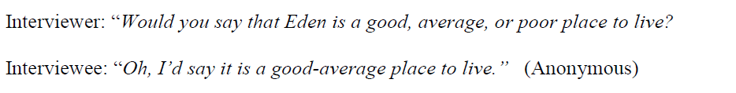
Self-report items—your experiences and measurement threats?

Slide 15
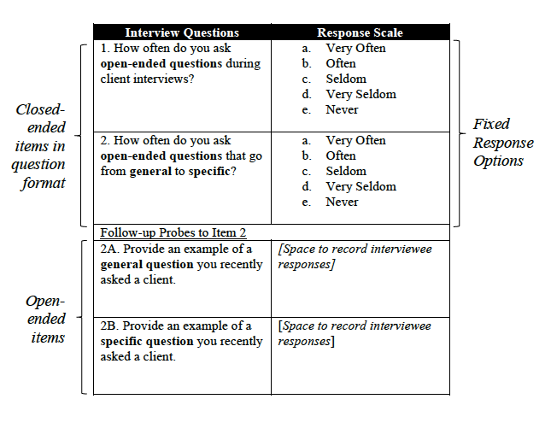
Self-reported item for counselor measure -(Interview)

Slide 16
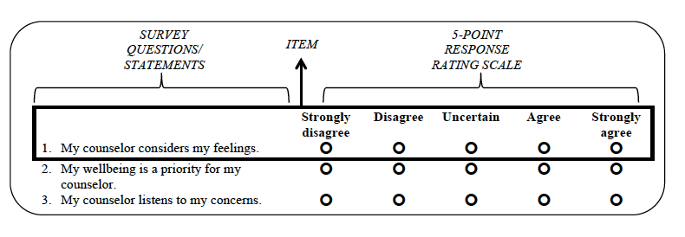
Survey Questionnaire (Likert scaled Items)

Slide 17
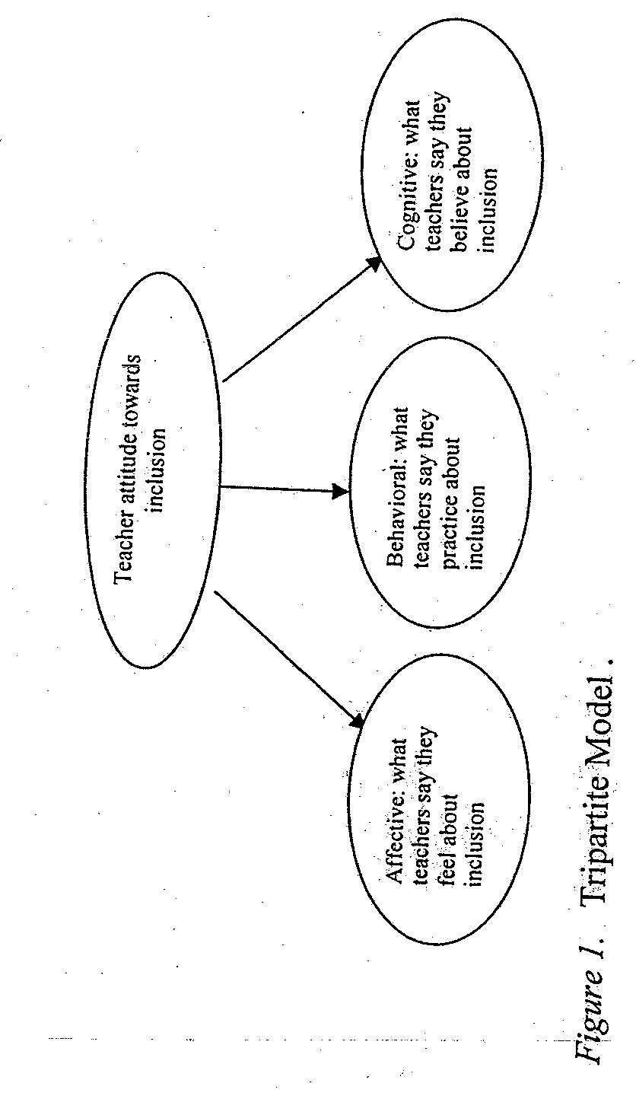
EXAMPLE: Teacher Attitude Towards Inclusive Education (TATIE (Sng, 2004)
NOTE: Application of Tripartite Model for Attitude Measurement(CAB- “cognitive” beliefs/opinions, affect, behavior,)

Slide 18
Content Validation Exercise
(Adapted from Teacher Attitude Towards Inclusive Education, TATIE—but not her items!)
Adapted from (Sng, 2004) General Indicator(s):
1. Teachers express what they feel about including students with disabilities in classes
2. Teachers express what they do OR would be willing to do with students with disabilities in an inclusion setting
3. Teachers express what they believe to be true about students with disabilities (e.g., positive versus negative stereotypes)
Are these items “content valid”?
I feel comfortable including students with disabilities in my classroom
Most students with disabilities like ADHD have little or no self-control and poor language skills
Few people are interested in how teachers feel about inclusion of LD students in mainstream classes
I am willing to adapt the time allowed for task completion
Teaching students with disabilities often agitates me
Best Response Options? Response scale?
Likert Scale is:
Strongly Agree, Agree, Uncertain, Disagree, Strongly Disagree

Slide 19
Practice-Are these good attitudinal items for measuring the TATIE domain?
1. Personalities of many LD children are convoluted. (SA-SD)
2. ADD students could sometimes be in inclusive classes. (SA-SD)
3. As a special education teacher, I should have nothing to do with non-ADD students. (SA-SD)
4. Dyslexic children and parents need to be given special care by schools. (SA-SD)
5. Given that they have anger control problems, teachers find it difficult to deal with serious ADD cases in inclusive classrooms. (SA-SD)
6. Teachers find it difficult to deal with serious ADD cases in inclusive classrooms (SA-SD)
7. I do not feel comfortable with full inclusion policies. (SA-SD)

Slide 20
Content-Validation Checklist for Survey-based Items:
Are item statements clear? Are they concrete? Are verbose items with semantic ambiguities avoided?
2. Do the answer options fit the stem of the item?
3. If used, are negatively oriented items clear and unambiguous? Are negatively oriented items sparingly and judiciously used?
4. Are items free of:
  jargon (e.g., use of technical terms such as "affective" or "attention deficit")
  abbreviations (e.g., ADD for Attention-Deficit Disorder, WHO for World Health Organization)
  biased language or content (e.g., the suggestion that boys have Attention Deficit Disorder more than girls)
5. Are double-or triple-barreled items absent? (e.g., tapping into more than one content dimension)
6. Are there sufficient levels of response categories to capture the natural variability of expected responses--the underlying distribution of the variable in the population?
7. Are there “leading” questions or items? Are there “loaded” questions or items?

Slide 21
Content-Validation Checklist for Survey-based Measures:
1. Do the assessment (items) show a match with the content and behaviors targeted in:
  indicators of the domain?
  developmental level, age, and other specifications of the intended population?
  assessment purposes?
2. Are directions for respondents/assessors/observers clear?
3. Are conditions clearly outlined for assessors in the instructions?
4. Are the scoring procedures clear and unambiguous?
5. Are there enough observations or items to generate reliable scopres and overall results?
6. Does the assessment appear to be free of the following biases:
  readability bias (keep reading level at 8th grade level)
  inflammatory bias
  Assessment conditions bias

Slide 22
Content-Validation Checklist for Written Structured Response (W-SR) Items:
1. Does the item match the content, behavior, condition, and taxonomic level in the targeted outcome?
2. Does the item have correct grammar, punctuation, and spelling?
3. Does the item have only one clear best or correct answer?
4. Is intricate or confusing language avoided?
5. Is the item free of any clues?
6. Is the item stated positively? If negative words are used, are they highlighted?

Slide 23
Additional Content-Validation Checklist for Interpretive Exercise Items:
1. Is the contextual material likely to be NEW to the student?
2. Is the information clear and easy to read?
3. Do the questions require higher order levels of thinking, analysis and interpretation?
4. Are items dependent on the contextual information?
5. Is the list of questions of appropriate length?
6. Is the answer key reasonable?

Slide 24
Additional Content-Validation Checklist for Interview-Based Assessment Tools:
1. Are interview questions provided?
2. Do instructions for interviewers/recorders clarify:
  the time allowed for each prompt?
  the probes allowed for each prompt?
  the method and degree of structure in coding responses?

Slide 25
PRACTICE IN ITEM-WRITING

Slide 26
Useful Taxonomies—Construct Domain Specification
Affective construct indicators typically tap into:
Beliefs, opinions and values—
What a person holds to be true about something, perceived knowledge (i.e., a person’s beliefs, opinions, values about some attitudinal object)
Feelings—
  What a person feels towards an object
  (fear, happiness, anxiety etc.)
Behaviors, practices—
  What a person would do in relation to an object
  (run, stay, engage, participate)
Experiences---
A person’s self-reports of past experiences with something
(pain, satisfaction)
This taxonomy is adapted from Rosenberg & Hovland (1960) and from
Chatterji (2003, Chapter 9).

Slide 27
Useful Taxonomies—Construct Domain Specification
Health construct indicators typically tap into symptoms of a health condition:
Physiological symptoms ( i.e., heart rate, etc)
Behavioral symptoms (i.e., what a person will say or do in a circumstance,like stutter, stumble, etc. )
Appearance indicators (i.e., what a person looks like, redness, pale, gaunt, etc.)

